Slide 1
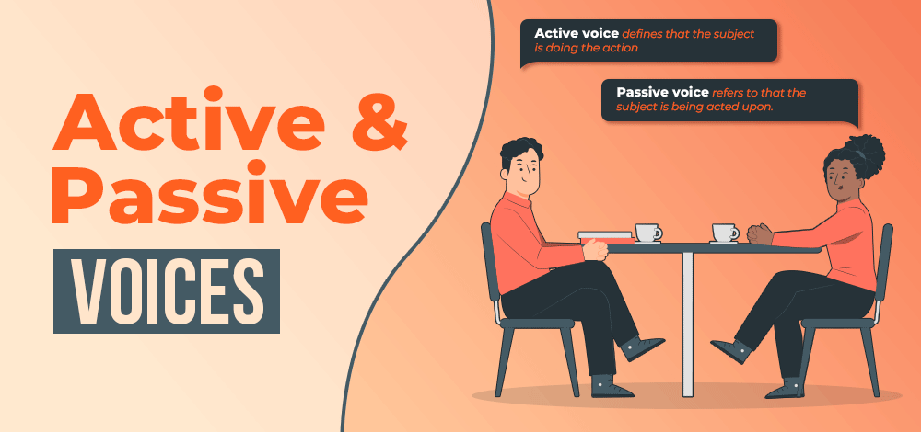

Slide 2
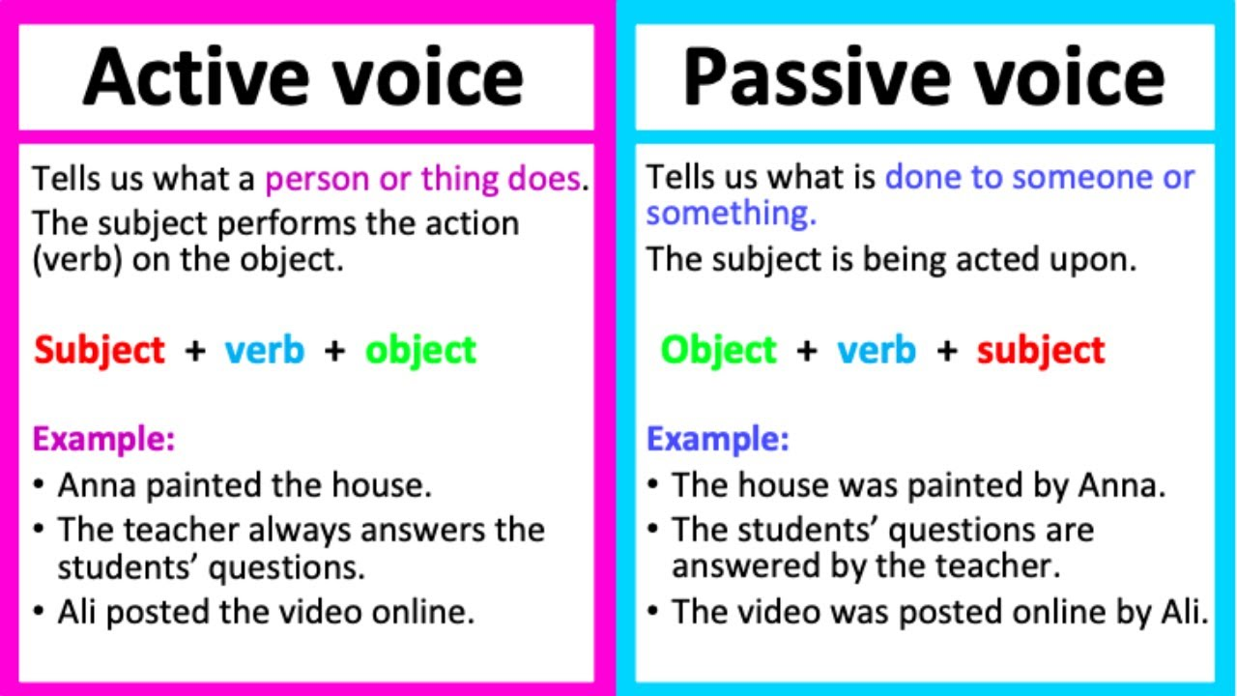

Slide 3
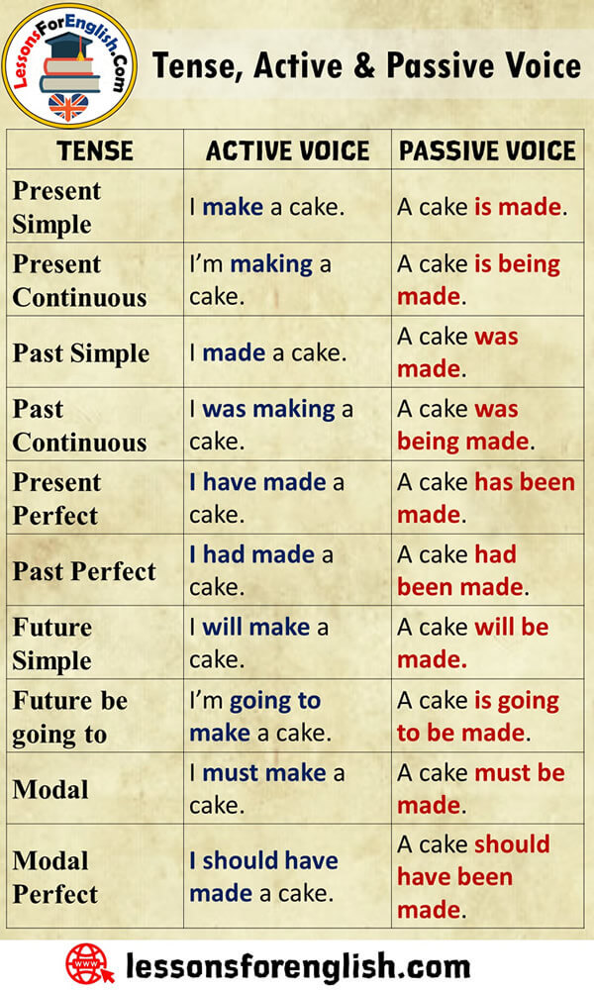

Slide 4
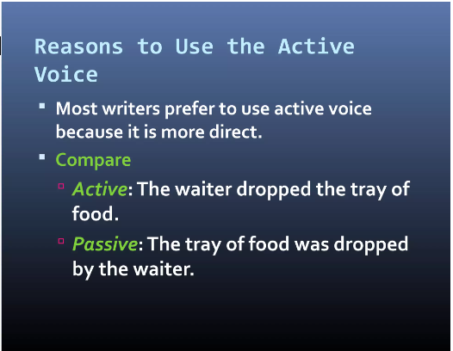

Slide 5
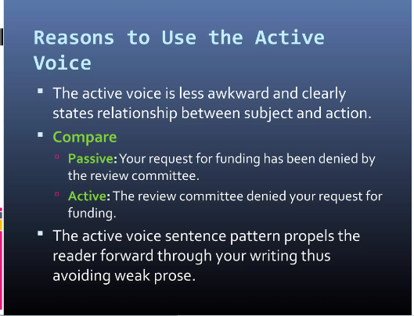

Slide 6
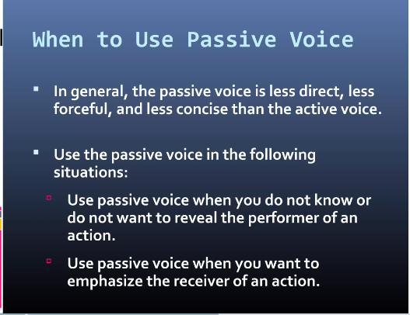

Slide 7
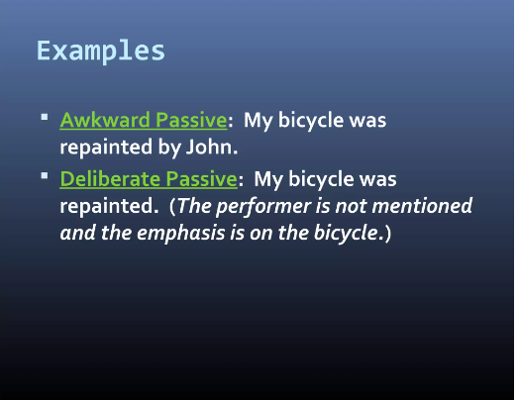

Slide 8
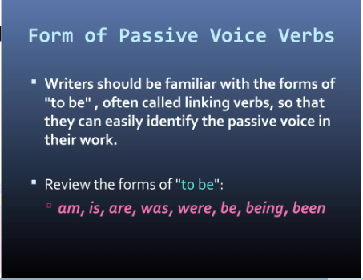

Slide 9
Active And Passive Voice Rules For Conversion of Sentence
Below are the active-passive voice rules to follow for changing an active sentence into a passive voice. Before heading to the rules of active-passive voice, let’s check the examples of active and passive voice sentences.
Conversion of Active and Passive voice examples
Rita wrote a letter. (Subject + Verb + Object)
A letter was written by Rita. (Object) + (auxiliary verb) + (past participle) + (by subject).
She cooks food. (Subject + Verb + Object)
The food is cooked by her. (Object) + (auxiliary verb) + (past participle) + (by subject)

Slide 10
Rules for Active – Passive Voice Conversions
Rule 1. Identify the (S+V+O) Subject, Verb and object in the active sentence to convert to passive voice
Example:
He drives car. (Subject – He, verb – Drives, object – Car)
Rule 2. Interchange the object and subject with each other, i.e. object of the active sentence become the subject of the passive sentence.
Example :
Active voice : She knits sweater. (Subject – She, Verb – Knits, Object – Sweater)
Passive Voice : The sweater is knitted by her. (Object sweater is interchanged with the subject She).

Slide 11
Rule 3. In passive voice sometimes the subject is not used, i.e. the subject in passive voice can be omitted if the sentence without it gives enough meaning.
Example :
Milk is sold in litres
Rule 4. Change the base verb in the active sentence into the past participle ie. third form verb in a passive sentence i.e. preceded by (By, With, to, etc). Base verbs are never used in passive voice sentences.
Example:
Active voice: She prepares dinner.
Passive voice: The dinner is prepared by her.
Active voice: She knows him.
Passive voice: He is known to her.
Active voice: Juice fills the jar.
Passive voice: The jar is filled with juice.

Slide 12
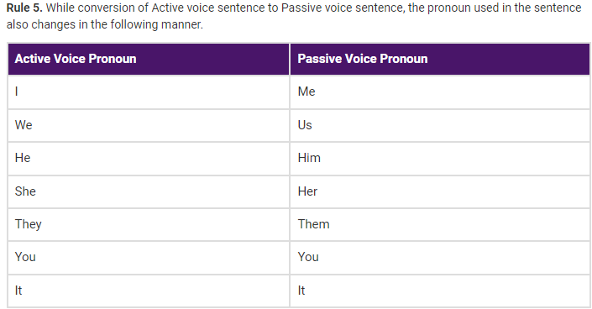

Slide 13
Rule 6. Use the suitable helping or auxiliary verb (is/am/are/was, etc.). The rules for using auxiliary verbs in passive voice sentences are different for each tense.
Example:
The letter is written by her
A book was not bought by her
Chocolates are being eaten by them.

Slide 14
USE OF PASSIVE IN PRESENT TENSE

Slide 15
PRESENT SIMPLE PASSIVE-
Forming Simple Present Passive Affirmative Form
Object + am / is / are + verb3 (past participle)
Question Form
Am / Is / Are + Object + verb3 (past participle) ?
Something is done by someone regularly / everyday / as expected...
Active : The gardener waters the flowers every evening.
Passive: The flowers are watered by the gardener every evening.

Slide 16
examples
1.He opens the door. - The door is opened by him.
2.We set the table. -The table is set by us.
3.She pays a lot of money. - A lot of money is paid by her.
4.I draw a picture. - A picture is drawn by me.
5.They wear blue shoes. - Blue shoes are worn by them.
6.They don't help you. -You are not helped by them.
7.He doesn't open the book. - The book is not opened by him.
8.You do not write the letter. - The letter is not written by you.
9.Does your mum pick you up? - Are you picked up by your mum?
10.Does the police officer catch the thief? - Is the thief caught by the police officer?

Slide 17
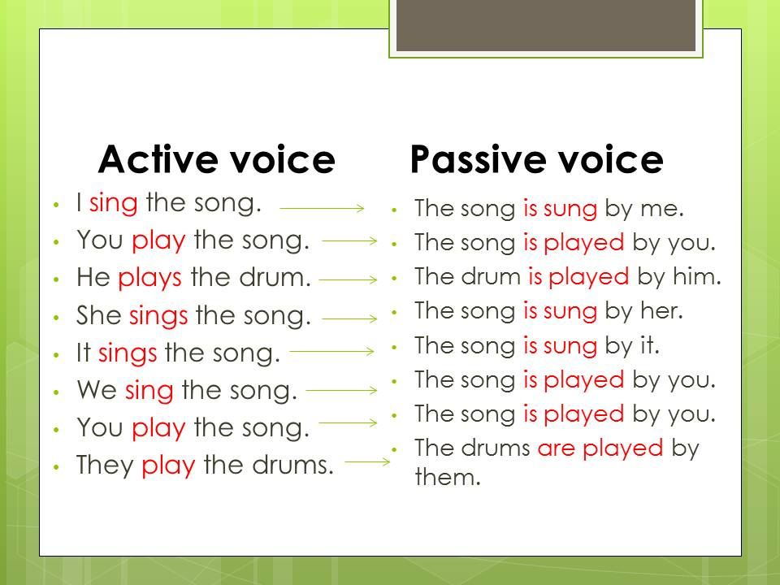

Slide 18
Present continuous, passive voice
The present continuous tense describes things that are happening now and in the future.
This tense is confusing because the verb "be" appears twice. But it’s not too difficult once you understand how it works: Subject + be (Present Simple) + -ing

Slide 19
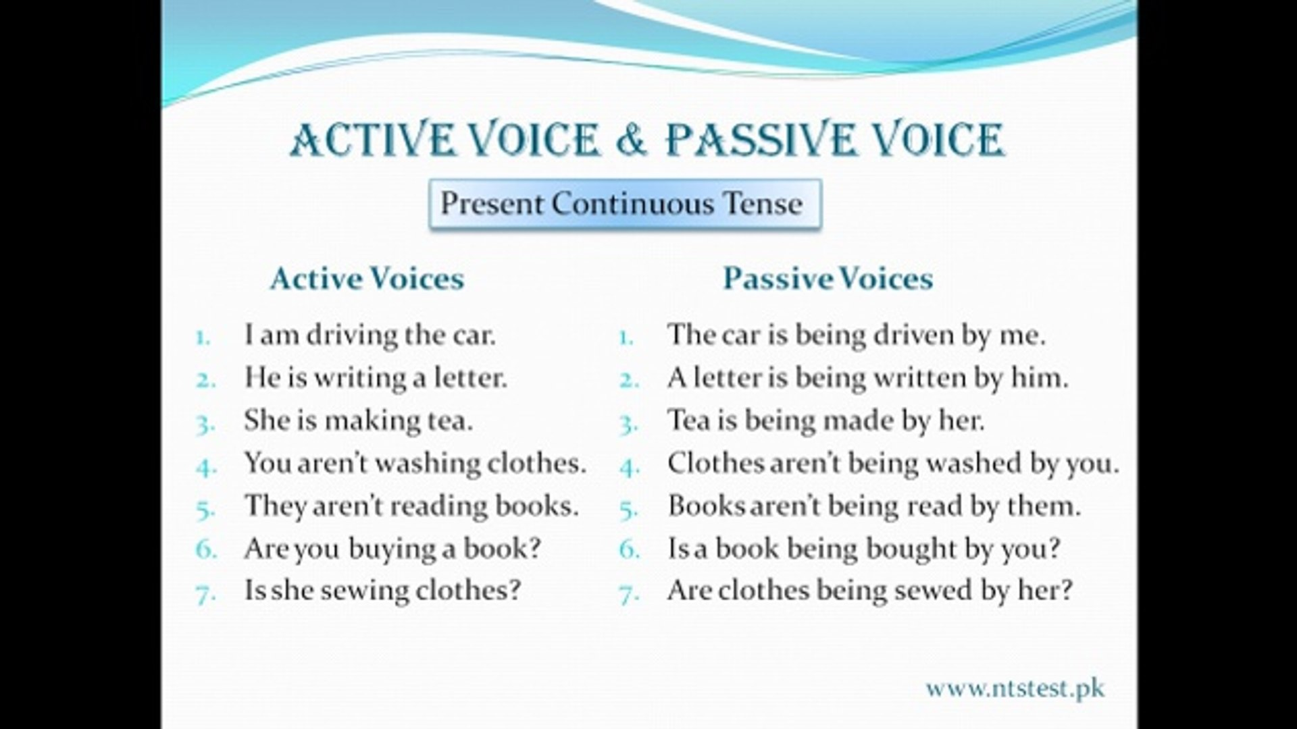

Slide 20
Forming Present Progressive Passive
Something is being done by someone at the moment. Active : The postman is delivering the mail. Passive: The mail is being delivered by the postman. Active : Harry Potter is measuring the room. Passive: The room is being measured by Harry Potter. Active : The coach is congratulating the team at the moment. Passive: The team is being congratulated by the coach. Active : Are they opening the gifts now? Passive: Are the gifts being opened by them ? (now)
Affirmative Form | Object + am / is / are + being + verb3
Question Form | Am / is / are + Object + being + verb3 ?

Slide 21
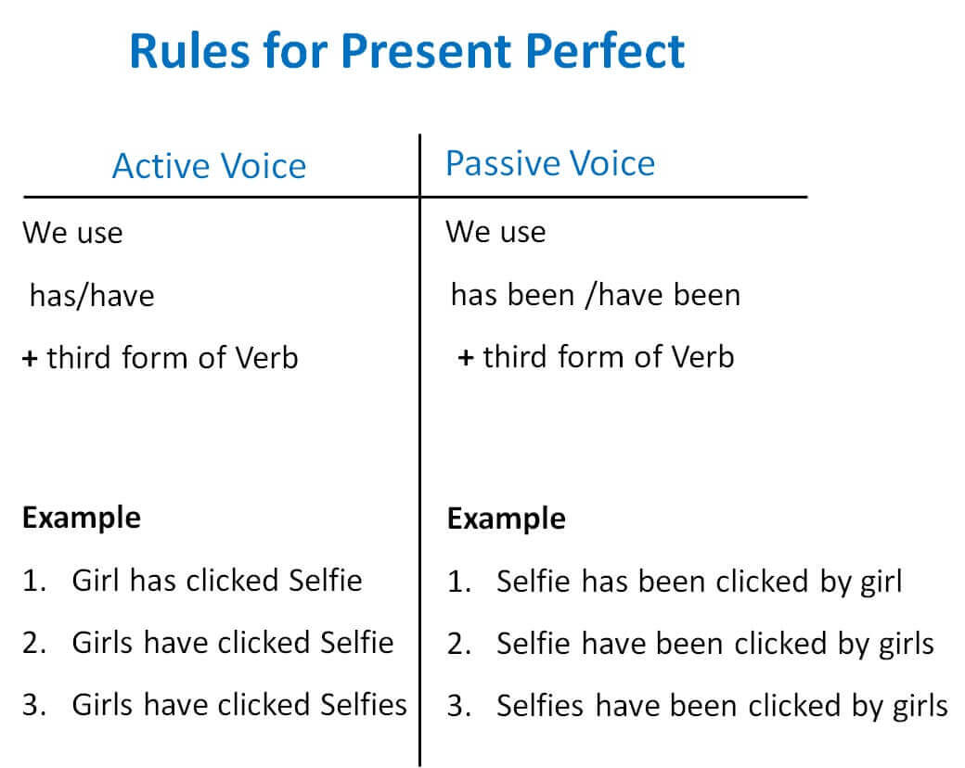

Slide 22
Passive present perfect
· Active : They have cleaned the house.
· Passive: The house has been cleaned by them.
Affirmative Form Object + have / has + been + verb (past participle)
Active Voice; Thomas has written many books.
Passive Voice ;Many books have been written by Thomas.

Slide 23
Question Form Have / has + object + been + verb(past participle)
Active form ; Have the police caught the man?
Passive voice ; Has the man been caught by the police?
· Negative Form:
Object + have / has + not + been + verb (past participle)
Active Voice ;Thomas hasn’t written many books.
Passive Voice ;Many books haven’t been written by Thomas.

Slide 24
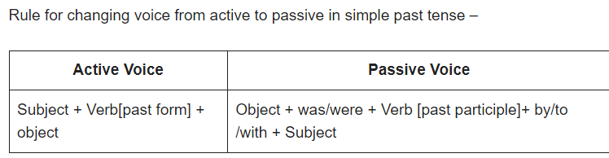
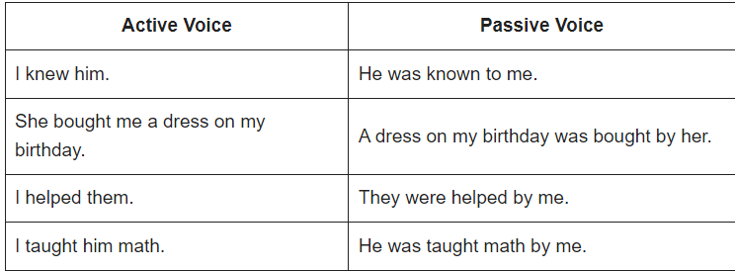

Slide 25
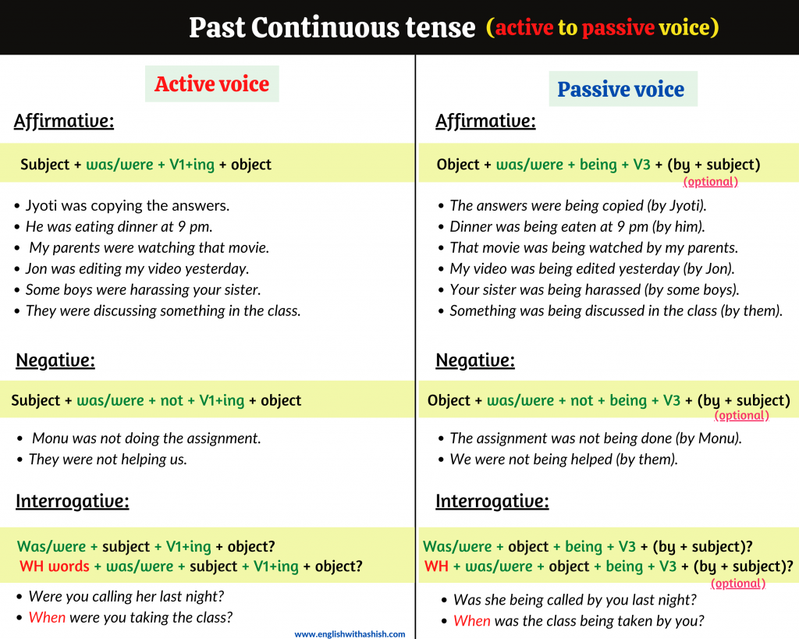

Slide 26
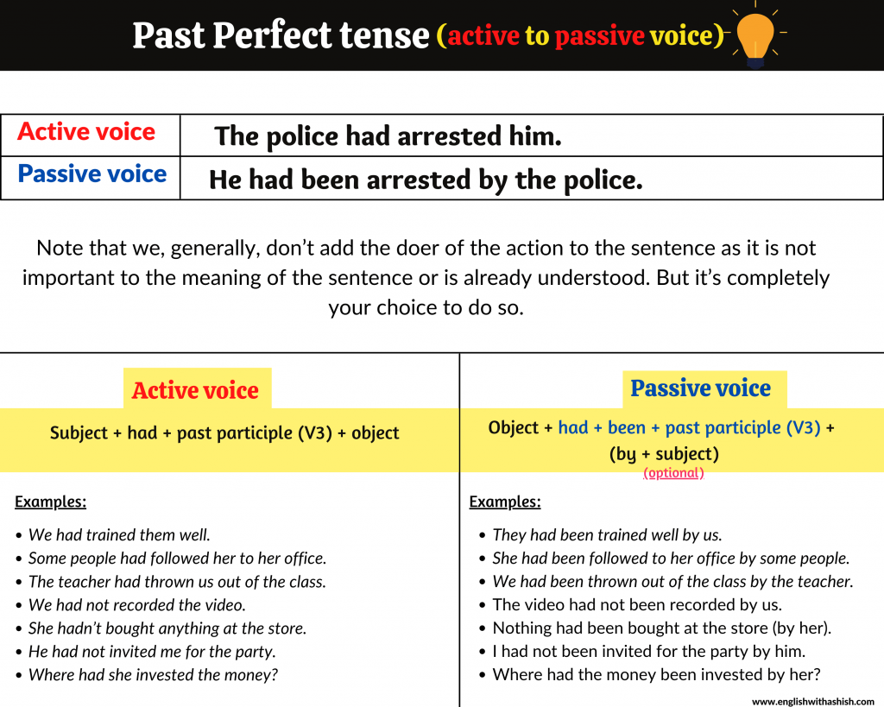

Slide 27
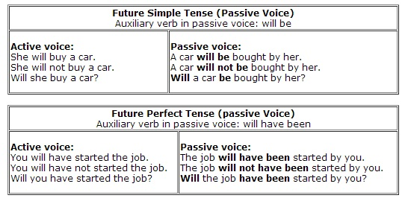

Slide 28
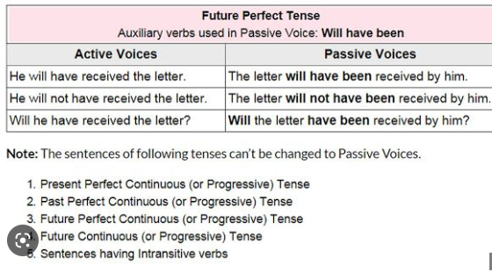

Slide 29
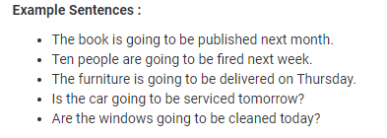

Slide 30
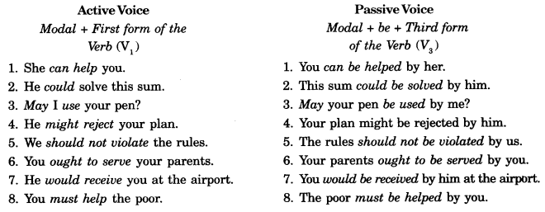

Slide 31
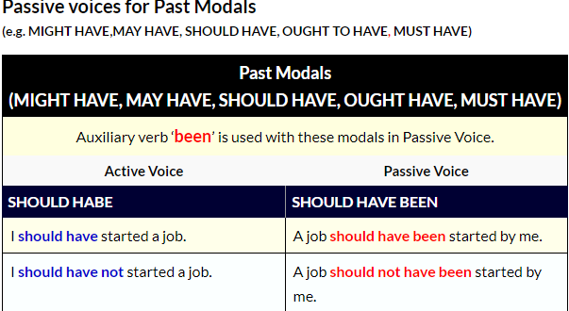
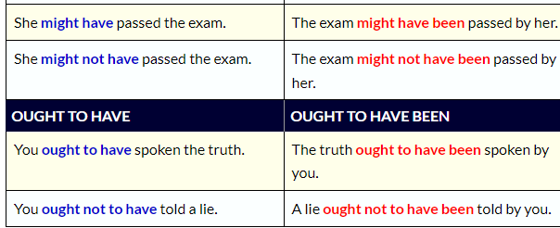

Slide 32
Convert :
1.This company employs a lot of people.
2.She cleans the office every day.
3.The final price includes all taxes.
4.Careless drivers cause many accidents.
5.My neighbors usually invite me to parties.
6.People use phones every day.
7.My wife makes delicious cakes.
8.My mother always wakes me up.
9.We plant one tree every year.
10.Loud noises disturb me easily.
11.Emma solves crosswords very fast.
12.Kevin prints documents every day.
13.They cut the grass once a month.
14.My boss organizes weekly meetings.
15.I feed my cat three times a day.

Slide 33
Answers
1.A lot of people are employed by this company.
2. The office is cleaned every day.
3.All taxes are included in the final price.
4.Many accidents are caused by careless drivers.
5.I am usually invited to parties.
6. Phones are used by people every day.
7.Delicious cakes are made by my wife.
8. I am always woken up by my mother.
9.One tree is planted by us every year.
10.I am easily disturbed by loud noises.
11.Crosswords are solved by Emma very fast.
12.Documents are printed by Kevin every day.
13.The grass is cut by them once a month.
14Weekly meetings are organized by my boss.
15.My cat is fed three times a day.

Slide 34
We should respect your teachers.
(A) Our teachers should be respect by us.
(B) Our teachers should be respected by us.
(C) Our teachers shall be respected by us.
(D) Our teachers should respected by us.

Slide 35
Ans. B

Slide 36
She has written letters.
(A) Letters were written by her.
(B) Letters have written by her.
(C) Letters are written by her.
(D) Letters have been written by her.

Slide 37
Ans .D

Slide 38
I was writing an essay.
(A) An essay was being written by me.
(B) An essay was written by me.
(C) An essay is being written by me.
(D) None of these

Slide 39
Ans. A

Slide 40
They will ask you a lot of questions at the interview.
A.You are asked a lot of questions at the interview.
B.You were being asked a lot of questions at the Interview.
C. You will be asked a lot of questions at the interview.
D.D You are being asked a lot of questions at the Interview.

Slide 41
Ans C

Slide 42


